Slide 1

MORTALITY PREDICTION
AI IN MEDICINE
‹#›

Slide 2
Aim of the Lecture
We aimed to develop and validate a prediction model for all-cause in-hospital mortality among ICU admitted patients
‹#›
Notes:
Image source: https://cs231n.github.io/classification

Slide 3
Goal
At the end of the lecture, you will;
Understand the projects workflow
Perform machine learning retrospective analysis on the MIMIC III dataset
Be able to develop a mortality prediction system for patients admitted to intensive care units( ICU) or under critical care based on their medical health data.
‹#›

Slide 4
Introduction
The prediction of in-hospital mortality for intensive care units (ICU) admitted HF patients remains poorly characterized. we aimed to develop a solutions using a predictive model for mortality prediction.
We considered in-hospital mortality in intensive care unit patients with heart failures.
‹#›

Slide 5
Tech Stacks
Scikit-learn Library
Streamlit web framework (Frontend)
Python (Backend)
‹#›

Slide 6
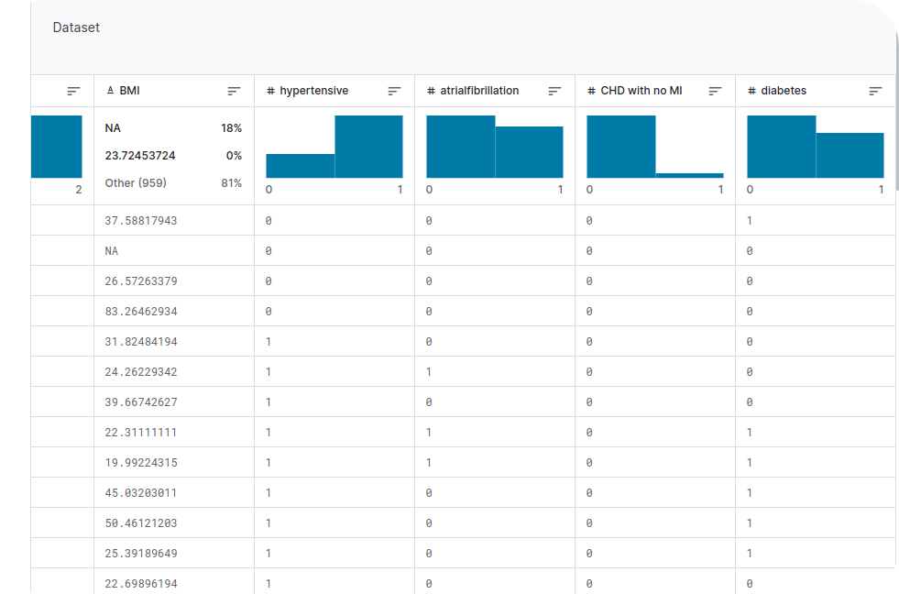
Model Training
Dataset
MIMIC III is a large, freely available database comprising de identified health-related data associated with over forty thousand patients who stayed in critical care units of the Beth Israel Deaconess medical center between 2001 and 2012.
‹#›

Slide 7
Model Training
Based on clinical relevance, the dataset is notable for three factors:
It is freely available to researchers worldwide
It encompasses a diverse and very large population of ICU patients
It contains highly granular data, including vital signs, laboratory results, and medications.
Different machine learning model was trained, evaluated and deployed on Streamlit web application framework for mortality prediction
‹#›

Slide 8
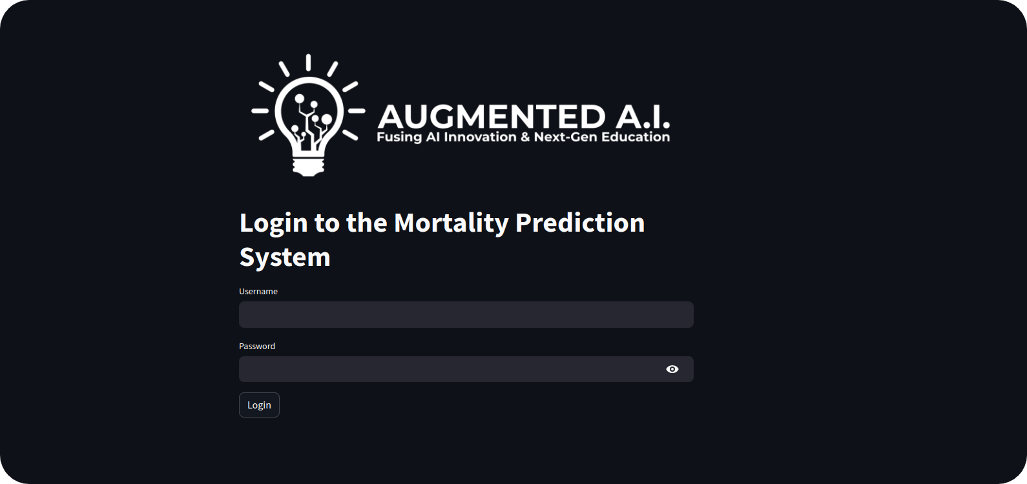
Application
‹#›

Slide 9
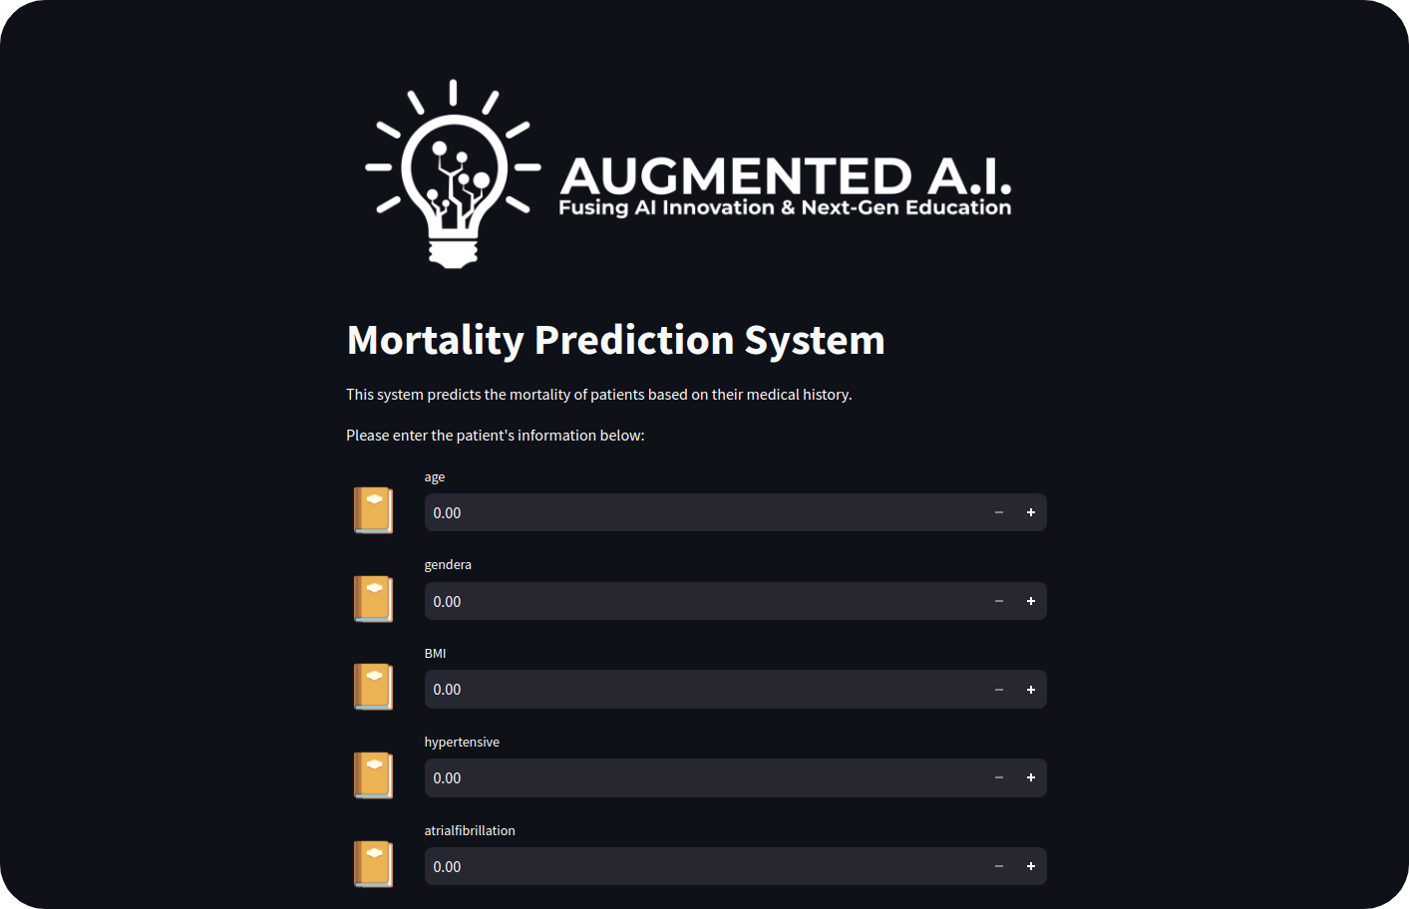
Application
‹#›

Slide 10
THANK YOU!
Web: www.augmentedstartups.com
WhatsApp: www.augmentedstartups.info/whatsapp

